Slide 1
The Oscilloscope shows voltage, Waveforms, & Phase shifts

Slide 2
What is an Oscilloscope?
The oscilloscope is an important piece of test equipment used in the world of electronics.
It provides a visual display of waveforms for measurement and comparison.
Waveform: a graph of voltage over a certain period of time

Slide 3
Why Use an Oscilloscope?
To View Waveforms
What does the shape of the waveform look like?
A waveform shows the changes in amplitude over a certain amount of time. The amplitude of the signal is measured on the y-axis (vertically), while time is measured on the x-axis (horizontally).
Typical waveform shapes include the sine wave, sawtooth wave and square wave.

Slide 4
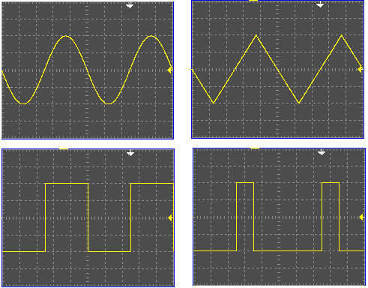
Viewing Waveforms

Slide 5
Why Use an Oscilloscope?
To Measure Waveforms
Amplitude: maximum voltage (high point) of the waveform; sometimes called peak voltage V_{P}; measured in volts (v)
Peak-to-Peak Voltage: V_{P-P} takes into consideration both the highest and the lowest points of the wave
Frequency: number of cycles per second; measured in hertz, kilohertz and megahertz

Slide 6
Measuring Waveforms
Pulse Width: the amount of time the pulse takes to go from low to high and back to low again
Phase Shift: when cycles are out of synch—sometimes on purpose, such as in a 3-phase electrical power transmission system
Duty Cycle: used as a measure of the amount of time a device can operate before it either needs a “rest” or wears out; expressed as a ratio of “on” duty vs. “off “ duty and written as a percentage

Slide 7
Measuring Waveforms
As seen in waveforms, the value of an AC voltage is continually changing from zero up to the positive peak, down through zero to the negative peak and back to up to zero and the positive peak again.
Therefore, AC voltage spends less time at peak voltage than a calculation using it would show, so this is not a good measure of its real effect.
Substitute the root mean square voltage (V_{RMS}) which is about 0.7 (70%) of the peak voltage (V_{p}), into equations: V_{RMS} = 0.707 × V_{P}

Slide 8
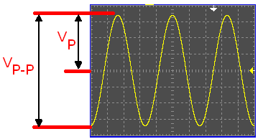
Measuring Waveforms
Amplitude

Slide 9
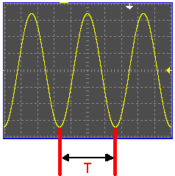
Measuring Waveforms
Frequency is the number of cycles per second
T = time period in seconds

Slide 10
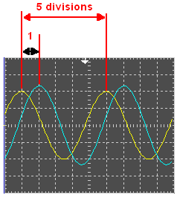
Measuring Waveforms
Phase Shift
Note: a full cycle = 360°

Slide 11
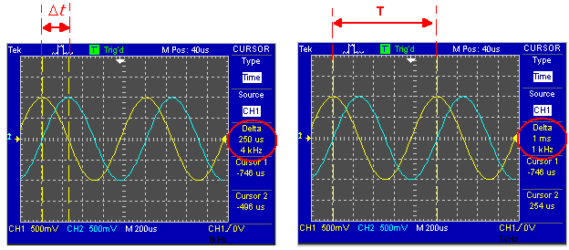
Measuring Waveforms
Phase Shift

Slide 12
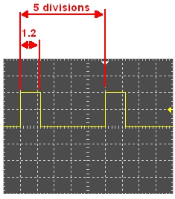
Measuring Waveforms
Duty Cycle

Slide 13
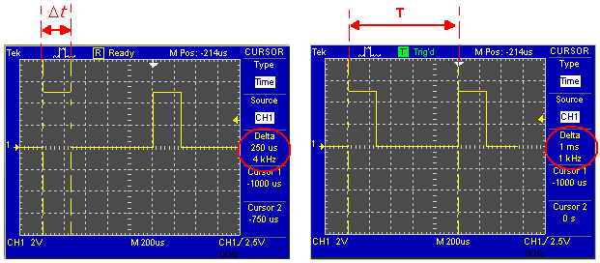
Measuring Waveforms
Duty Cycle

Slide 14
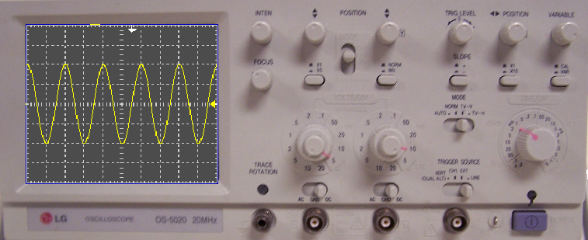
Measuring Waveforms
Example

Slide 15
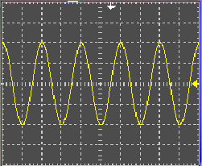
Measuring Waveforms
Example

Slide 16
Measuring Waveforms
Example

Slide 17
Measuring Waveforms
Example
10 Vp or 20 Vp-p Sine Wave @ 500 Hz

Slide 18
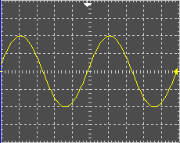
Time for a little review…
Determine the amplitude of the signal
Oscilloscope Settings
100 mV/div, 200 uS/div

Slide 19
Time for a little review…
Determine the amplitude of the signal
Oscilloscope Settings
100 mV/div, 200 uS/div
Answer:

Slide 20
Time for a little review…
Determine the Period of the signal
Oscilloscope Settings
5 V/div, 200 uS/div

Slide 21
Time for a little review…
Determine the Period of the signal
Oscilloscope Settings
5 V/div, 200 uS/div
Answer:

Slide 22
Time for a little review…
Determine the Frequency of the signal
Oscilloscope Settings
5 V/div, 200 uS/div

Slide 23
Time for a little review…
Determine the Frequency of the signal
Oscilloscope Settings
5 V/div, 200 uS/div

Slide 24
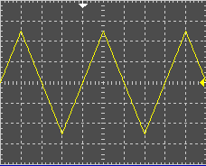
Time for a little review…
Determine the amplitude of the signal
Oscilloscope Settings
2 V/div, 500 uS/div

Slide 25
Time for a little review…
Determine the amplitude of the signal
Oscilloscope Settings
2 V/div, 500 uS/div
Answer:

Slide 26
Time for a little review…
Determine the Period of the signal
Oscilloscope Settings
2 V/div, 500 uS/div

Slide 27
Time for a little review…
Determine the Period of the signal
Oscilloscope Settings
2 V/div, 500 uS/div
Answer:

Slide 28
Time for a little review…
Determine the Frequency of the signal
Oscilloscope Settings
2 V/div, 500 uS/div

Slide 29
Time for a little review…
Determine the Frequency of the signal
Oscilloscope Settings
2 V/div, 500 uS/div
Answer:

Slide 30
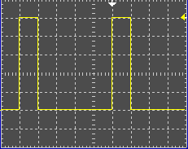
Time for a little review…
Determine the amplitude of the signal
Oscilloscope Settings
1 V/div, 2 mS/div

Slide 31
Time for a little review…
Determine the amplitude of the signal
Oscilloscope Settings
1 V/div, 2 mS/div
Answer:

Slide 32
Time for a little review…
Determine the Period of the signal
Oscilloscope Settings
1 V/div, 2 mS/div

Slide 33
Time for a little review…
Determine the Period of the signal
Oscilloscope Settings
1 V/div, 2 mS/div
Answer:

Slide 34
Time for a little review…
Determine the Frequency of the signal
Oscilloscope Settings
1 V/div, 2 mS/div

Slide 35
Time for a little review…
Determine the Frequency of the signal
Oscilloscope Settings
1 V/div, 2 mS/div
Answer:

Slide 36
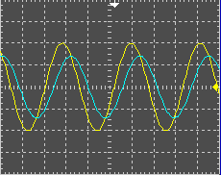
Time for a little review…
Determine the Phase Shift of the signal

Slide 37
Time for a little review…
Determine the Phase Shift of the signal
Answer:

Slide 38
Time for a little review…
Determine the Duty Cycle of the signal
Oscilloscope Settings
1 V/div, 2 mS/div

Slide 39
Time for a little review…
Determine the Duty Cycle of the signal
Oscilloscope Settings
1 V/div, 2 mS/div
Answer:

Slide 40
How do you get the signal from the source into the oscilloscope?
An oscilloscope probe is used to connect the oscilloscope input to the signal source.
The probe provides a high input impedance, proper shielding from noise, and capacitive correction.

Slide 41
The Oscilloscope Probe
The larger the signal, the greater the level of attenuation required.
Attenuation: A decrease in signal amplitude during its transmission from one point to another.
Scope probes are available with many levels of attenuation:
1X
10X
100X
1000X

Slide 42
A Typical Oscilloscope Probe

Slide 43
The Oscilloscope Probe
Recall that impedance is opposition to current flow in an alternating current circuit. It is made up Resistance (R) + Reactance (X).
The probe provides a high input impedance, proper shielding from noise, and capacitive correction.
Ground clip should be used to help reduce “electrical noise” on the signal.

Slide 44
The Oscilloscope Probe
Correct Form Over Compensated Under Compensated

Slide 45
The Oscilloscope Probe Review
The oscilloscope is an important piece of test equipment used in the world of electronics.
The oscilloscope probe brings the signal into the oscilloscope, while keeping signal degradation at a minimum.

Slide 46
For More Information
XYZs of Oscilloscopes http://www.tek.com/learning/oscilloscope-tutorial/
Oscilloscope Tutorial video http://www.youtube.com/watch?v=MmU9kRMDURw&feature=related
Single Phase Power vs. Three Phase Power http://electrical-engineering-portal.com/single-phase-power-vs-three-phase-power

